Slide 1
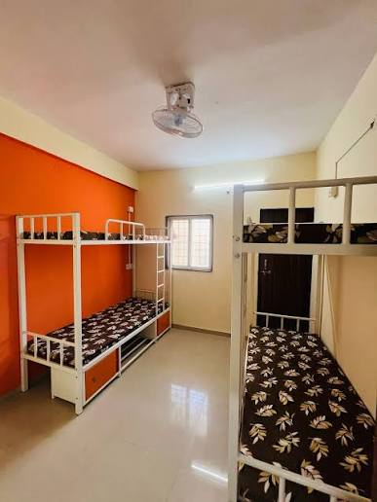
DATABASE PROJECT • MYSQL
PG HOSTEL
STUDENT MANAGEMENT SYSTEM
A practical SQL project for managing rooms, students,
payments and visitor records.
Database design
SQL queries
Reports & insights
Presented by: Mukesh Pagoti
01

Slide 2
Project Overview
Problem Statement
Project Objectives
Hostel records may be stored in registers or separate files.
Manual tracking makes payment follow-up and room lookup harder.
A central database keeps related information organised.
Store student, room, payment and visitor details.
Retrieve records quickly using SQL queries.
Identify pending payments and room occupancy.
CORE MODULES
Rooms
Students
Payments
Visitors
01
02
03
04
Capacity, rent, beds
Profile and room link
Amount and status
Guest and visit date
Technology: MySQL • SQL • Relational database concepts
02 | PG HOSTEL STUDENT MANAGEMENT SYSTEM
2

Slide 3
Database Design & Relationships
ROOMS
STUDENTS
room_id (PK)
room_number
room_type, capacity
monthly_rent, available_beds
1 : Many
student_id (PK)
student_name, gender
phone, college, course
room_id (FK)
1 : Many
1 : Many
PAYMENTS
VISITORS
payment_id (PK)
student_id (FK)
payment_date, amount
payment_status, payment_month
visitor_id (PK)
student_id (FK)
visitor_name, relationship
visit_date
PK = Primary Key • FK = Foreign Key
03 | PG HOSTEL STUDENT MANAGEMENT SYSTEM
3

Slide 4
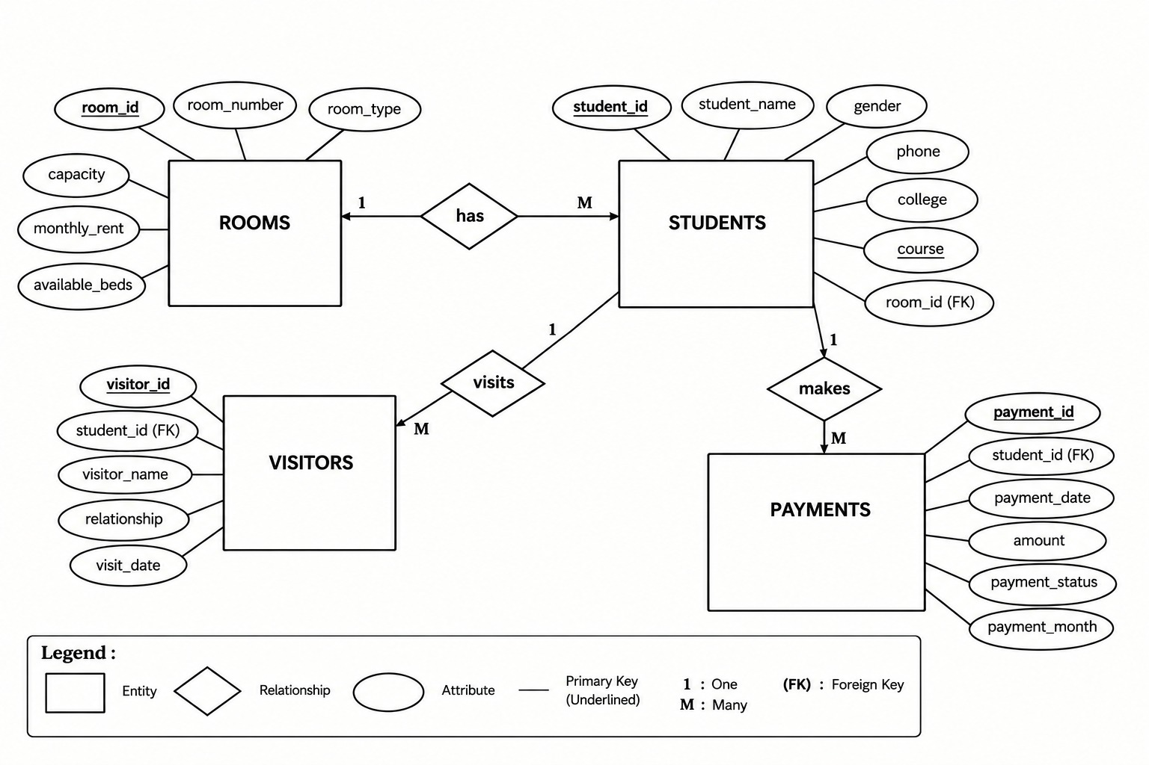
ER Diagram
03 | PG HOSTEL STUDENT MANAGEMENT SYSTEM
4

Slide 5
Sample Data in the Database
ROOMS
STUDENTS
Room | Type | Capacity | Rent (₹)
101 | Single | 1 | 6,000
102 | Double | 2 | 4,500
103 | Double | 2 | 4,500
104 | Triple | 3 | 3,500
105 | Double | 2 | 4,500
Name | Course | Room
Ramana | MCA | 101
Anil | B.Tech | 102
Anusha | B.Sc | 102
Bharat | B.Tech | 103
Deepika | MCA | 104
PAYMENTS
VISITORS
Student ID | Month | Amount (₹) | Status
1 | Sep 2026 | 6,000 | Paid
1 | Oct 2026 | 6,000 | Paid
2 | Oct 2026 | 4,500 | Pending
5 | Oct 2026 | 4,500 | Pending
Visitor | Relationship | Visit Date
Suresh Kumar | Father | 2026-10-02
Ravi Kumar | Brother | 2026-10-03
Lakshmi | Mother | 2026-10-04
Mahesh | Friend | 2026-10-05
Sample dataset from the project script; 5 rooms, 10 students and 7 visitor records.
04 | PG HOSTEL STUDENT MANAGEMENT SYSTEM
5

Slide 6
SQL Queries: Operations
1. View student records
2. Find students by course
SELECT student_name, phone, course
FROM Students;
SELECT * FROM Students
WHERE course IN ('MCA', 'B.Tech');
3. Count total students
4. Find pending payments
SELECT COUNT(*) AS total_students
FROM Students;
SELECT DISTINCT s.student_name
FROM Students s JOIN Payments p
ON s.student_id = p.student_id
WHERE p.payment_status = 'Pending';
Filtering
Sorting
Summaries
WHERE, IN, BETWEEN, LIKE
ORDER BY and LIMIT
COUNT, SUM, AVG, MIN, MAX
05 | PG HOSTEL STUDENT MANAGEMENT SYSTEM
6

Slide 7
Joins & Advanced SQL Features
JOINs
Query Tools
Database Features
INNER JOIN: matching rows
LEFT JOIN: all left rows
RIGHT JOIN: all right rows
CROSS JOIN: combinations
GROUP BY + HAVING
Subqueries
CTE (WITH clause)
UNION / UNION ALL
VIEW for reusable query
INDEX for lookup support
CASE for conditional labels
Transactions + ROLLBACK
Example: show each student's room
Why use these features?
SELECT s.student_name, r.room_number, r.monthly_rent
FROM Students s
INNER JOIN Rooms r ON s.room_id = r.room_id;
Combine related tables
Summarise and compare data
Reuse common query logic
Support faster data retrieval
06 | PG HOSTEL STUDENT MANAGEMENT SYSTEM
7

Slide 8
Project Output & Useful Reports
10
Students
5
Rooms
2
Pending payment rows
7
Visitor records
Example report: students per room
Example report: payment status
Room | Students assigned
101 | 1
102 | 2
103 | 2
104 | 3
105 | 2
Student | Amount (₹) | Status
Ramana | 6,000 | Paid
Anil | 4,500 | Pending
Charan | 4,500 | Pending
Anusha | 4,500 | Paid
07 | PG HOSTEL STUDENT MANAGEMENT SYSTEM
8

Slide 9
Some SQL Queries
Second-highest room rent
Students who never made a payment
SELECT MAX(monthly_rent)
FROM Rooms
WHERE monthly_rent < (
SELECT MAX(monthly_rent) FROM Rooms
);
SELECT s.student_id, s.student_name
FROM Students s
LEFT JOIN Payments p ON s.student_id = p.student_id
WHERE p.student_id IS NULL;
Total paid by each student
Rooms with most students
SELECT s.student_name,
COALESCE(SUM(p.amount), 0) AS total_paid
FROM Students s LEFT JOIN Payments p
ON s.student_id = p.student_id
WHERE p.payment_status = 'Paid'
GROUP BY s.student_id, s.student_name;
SELECT r.room_number, COUNT(s.student_id) AS total
FROM Rooms r JOIN Students s ON r.room_id = s.room_id
GROUP BY r.room_id, r.room_number
ORDER BY total DESC LIMIT 1;
08 | PG HOSTEL STUDENT MANAGEMENT SYSTEM
9

Slide 10
Learning Outcomes & Future Enhancements
What the Project Demonstrates
Possible Improvements
Relational database design with primary and foreign keys.
CRUD-style data retrieval and filtering with SQL.
Joins, aggregates, subqueries, CTEs and views.
Constraints, indexes and transaction basics.
Calculate available beds from room capacity and occupancy.
Add a room-allocation date and student check-in/check-out.
Prevent duplicate monthly payment records per student.
Add stored procedures, triggers and a web-based interface.
09 | PG HOSTEL STUDENT MANAGEMENT SYSTEM
10

Slide 11
THANK YOU

